Slide 1
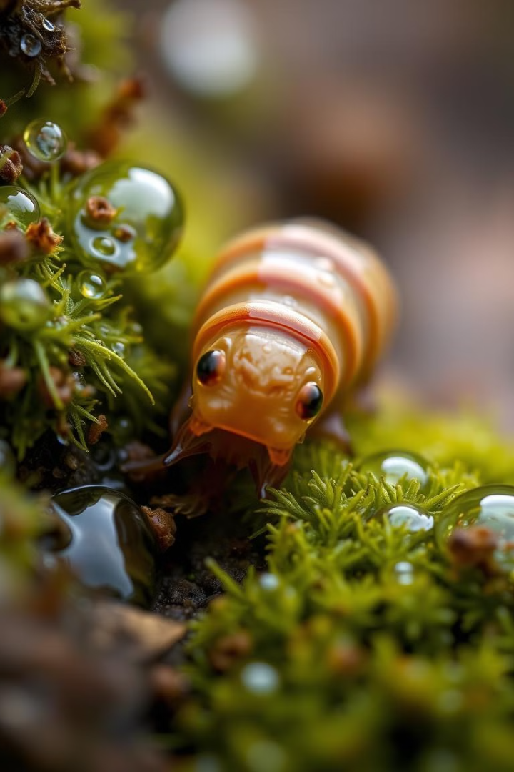

Biomimicry for Vaccine Storage: A Nature-Inspired Solution
The global need for effective vaccine storage has prompted researchers to explore alternative methods that can overcome the limitations of traditional refrigeration. Biomimicry, the practice of learning from nature to solve human challenges, offers a promising approach.
By: Ashmitha Suma Raj(1NH24CS402)
Sahana(1NH24CS403)
Anvesha(1NH23CS126)
Notes:
1

Slide 2
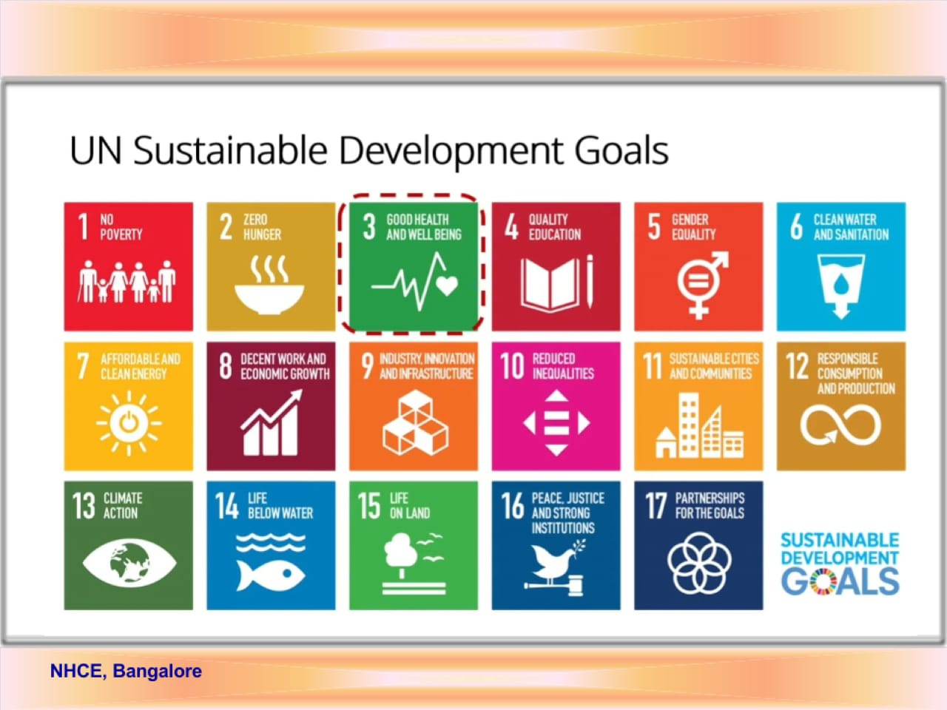

Slide 3

Contents
Define
Biologize
Discover
Abstract
Emulate
Evaluate
References

Slide 4
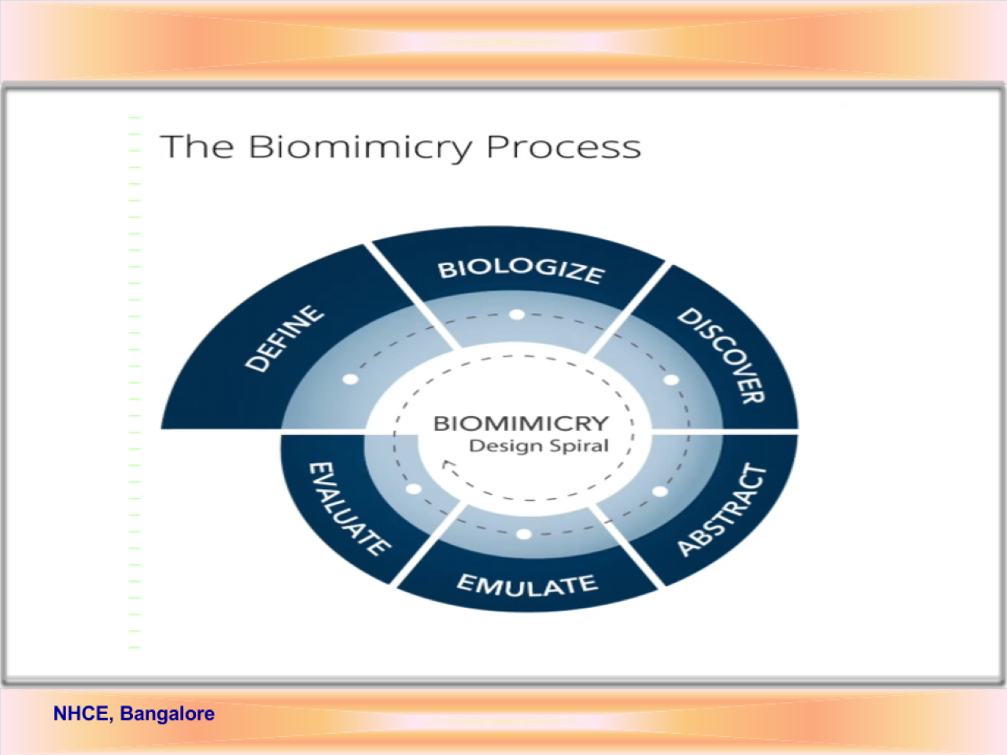

Slide 5
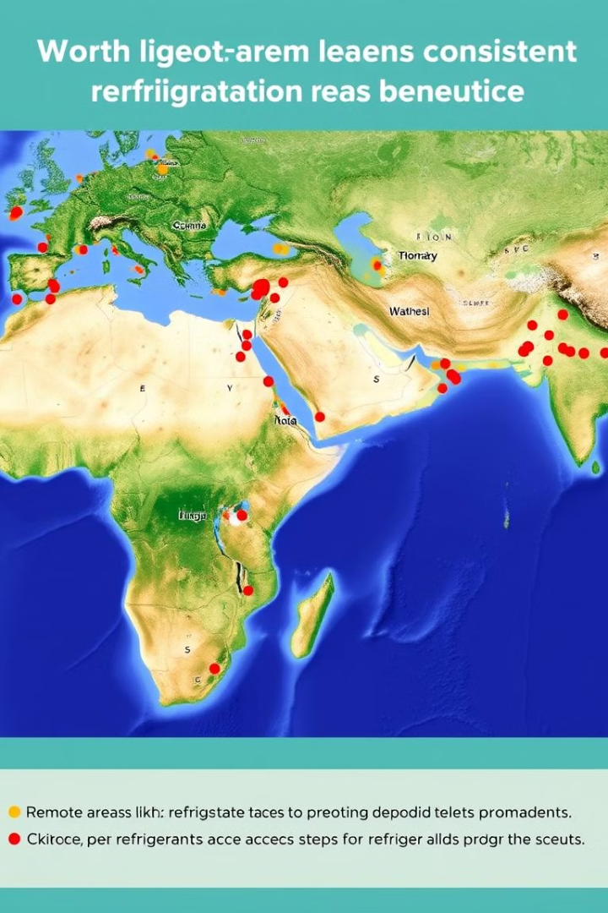
Define the Challenge
Goal
Obstacles
Develop a vaccine storage method that maintains potency without refrigeration.
Vaccines require specific temperature ranges, which are difficult to maintain in remote areas.
Notes:
2

Slide 6
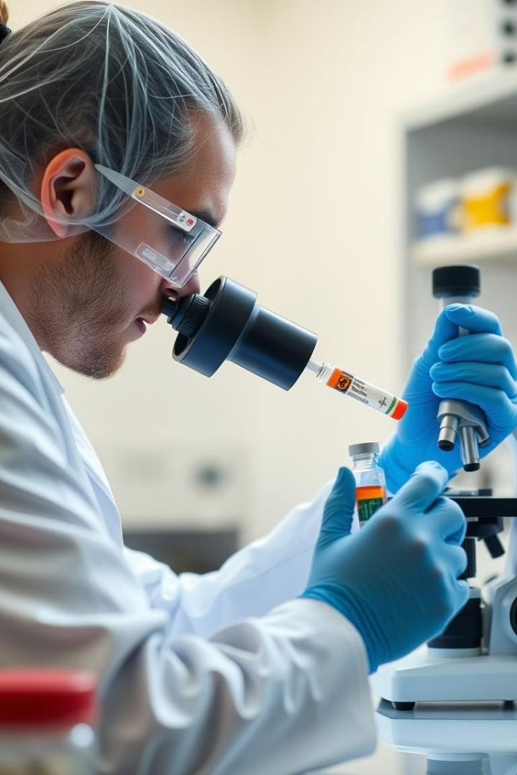
Biologize the Challenge
1
Stabilization
2
Preservation
How to protect vaccine components from temperature fluctuations and maintain their integrity.
Methods to prevent degradation of delicate structures over extended periods, ensuring vaccine efficacy.
3
Natural Preservatives
Identify substances from nature that can act as protective agents to maintain vaccine stability.
Notes:
4

Slide 7
Discover Nature's Solutions
Tardigrades
Desert Beetles
Seeds
These microscopic creatures can survive extreme temperatures by entering a state of cryptobiosis, where they dehydrate and reduce metabolic rates.
These insects have evolved efficient mechanisms to store moisture in arid environments, preventing dehydration.
Seeds utilize proteins and sugars, like trehalose, to maintain viability for extended periods in dry conditions.
Notes:
3

Slide 8
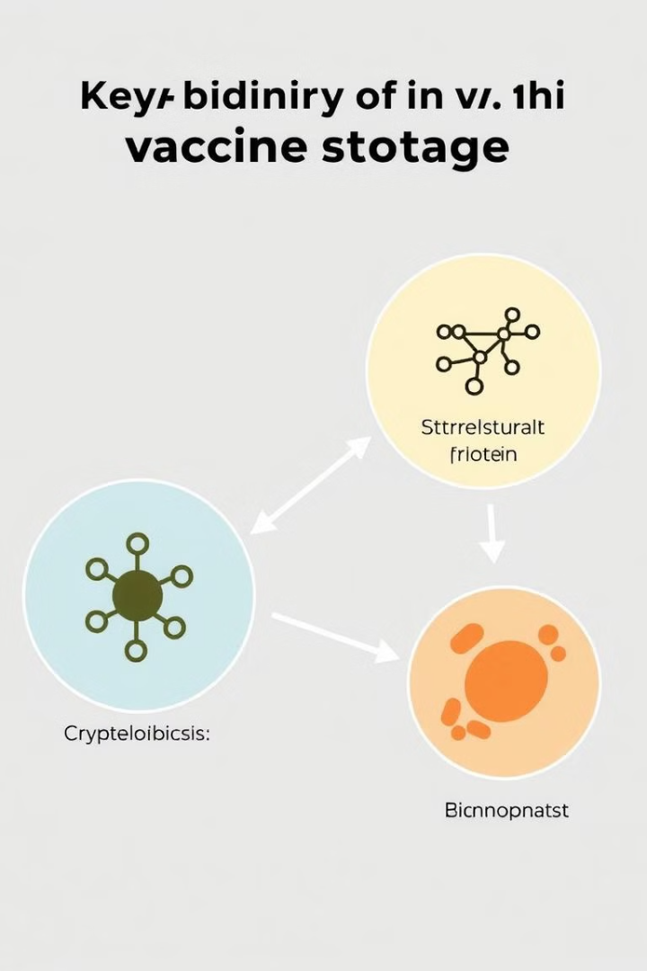



Abstract Key Principles
Cryptobiosis
Organisms reduce metabolic rates and dehydrate to minimize damage from extreme conditions.
Structural Proteins and Sugars
Organisms utilize protective sugars, like trehalose, to stabilize cellular structures during stress.
Microenvironments
Certain animals create micro-environments that buffer against temperature fluctuations, maintaining stability.
Notes:
5

Slide 9




Emulate Nature's Strategies
Tardigrade-inspired Coatings
Develop protective coatings that mimic the resilience of tardigrades, shielding vaccines from environmental stressors.
Sugar-based Stabilizers
Incorporate trehalose or similar sugars into vaccine formulations to stabilize sensitive components during storage.
Micro-packaging
Design packaging that mimics natural insulation, like desert animal burrows, to minimize temperature fluctuations.
Notes:
6

Slide 10
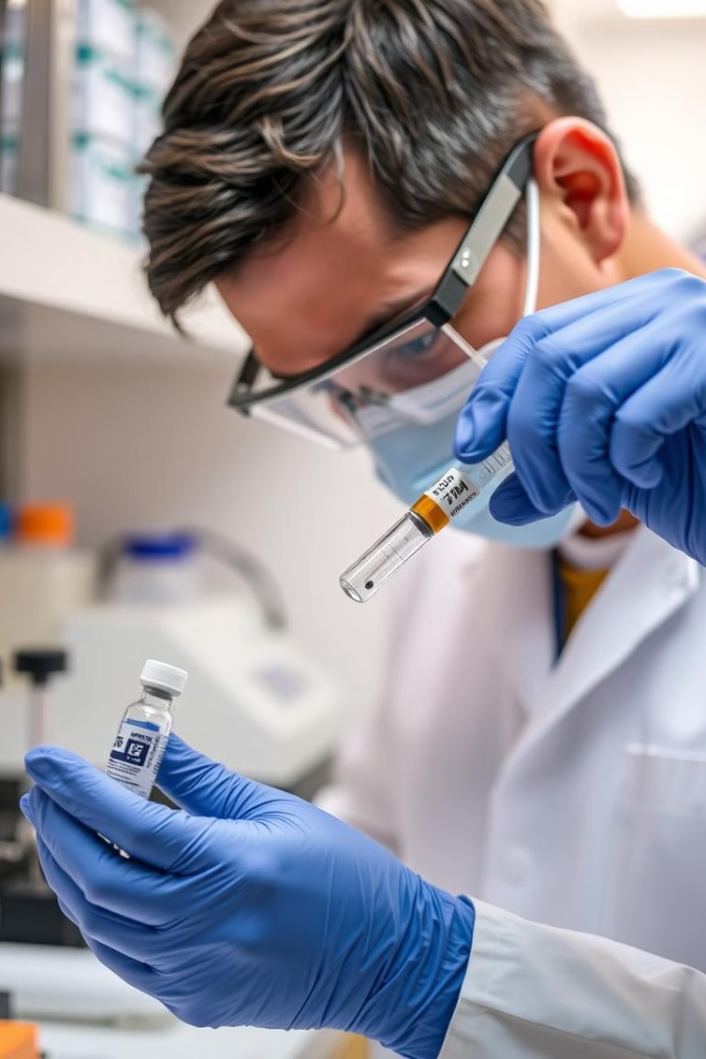
Evaluate and Refine
Step
Action
1
Conduct laboratory tests to evaluate the effectiveness of stabilizing agents in preserving vaccine potency.
2
Assess the durability, cost-effectiveness, and ease of transport of the biomimicry-inspired packaging in various climates.
3
Refine storage methods based on test results, optimizing performance, ease of use, and scalability as needed.
Notes:
7

Slide 11
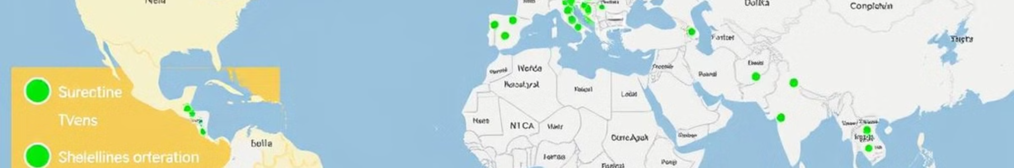
Impact and Future Directions
Increased Access
Continued Research
Biomimicry-inspired storage methods can expand vaccine access to remote and underserved areas.
Further exploration of natural principles and advancements in materials science will lead to even more innovative solutions.
1
2
3
Reduced Reliance on Refrigeration
This approach offers a sustainable alternative to traditional refrigeration, minimizing environmental impact and costs.
Notes:
8

Slide 12
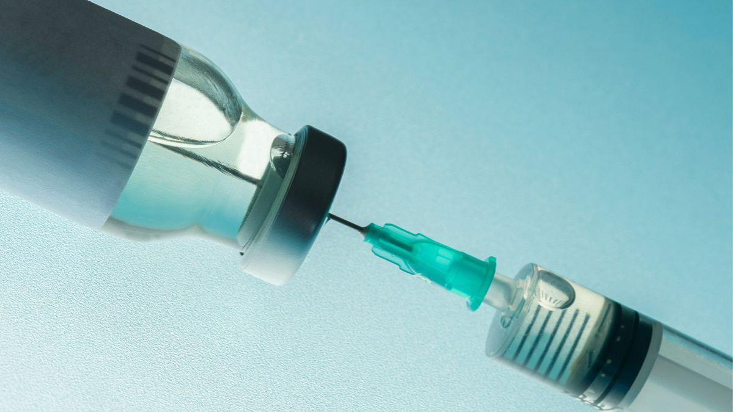
References:
https://www.learnbiomimicry.com/blog/best-biomimicry-examples(Learn Biomimicry. Com)

